Slide 1
Contents (Learnings from ongoing GET trainee programme)
1.All Electrical equipments maintainence in casting yard(faults detection,inspection and replacement)
2.Total erection of batching plant and complete electrical wiring connected for its operation.
3.Total erection of 150/25T gantry erection and complete electrical wiring associated for its operation.

Slide 2
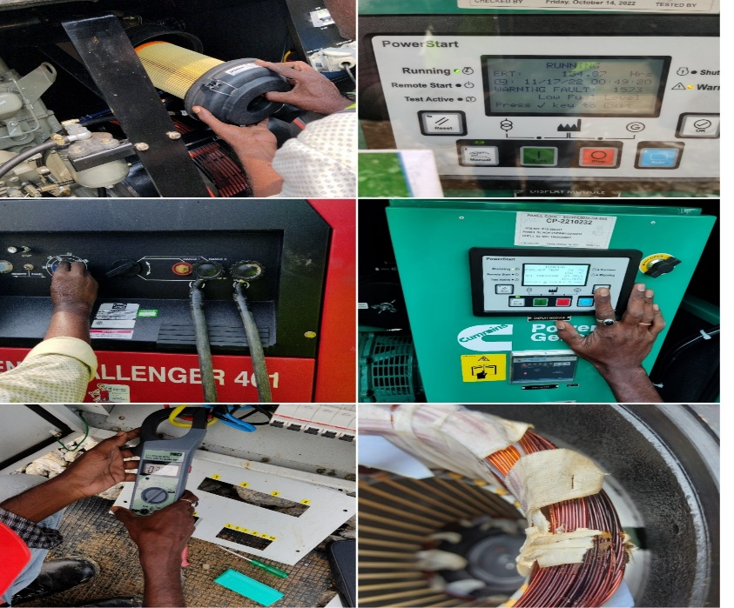
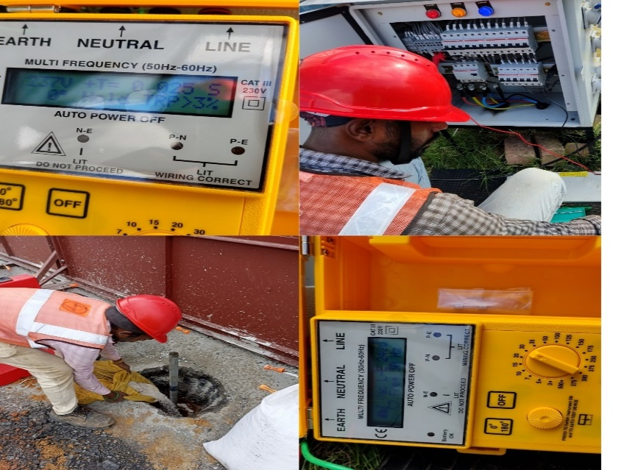
I.Electrical equipments maintainence
In electrical maintainence
1. ELCB testing
2. Earth testing
3. Winding core fault detection and replacement.
4. Earthing procedures
5. Cable burst due to overload replacing it and learned how to recover.
6.Cables installation of overhead type(35,240sqmm)
7.All DG’s maintainence in casting yard
8. starters(star-delta) connection procedures to all motors

Slide 3
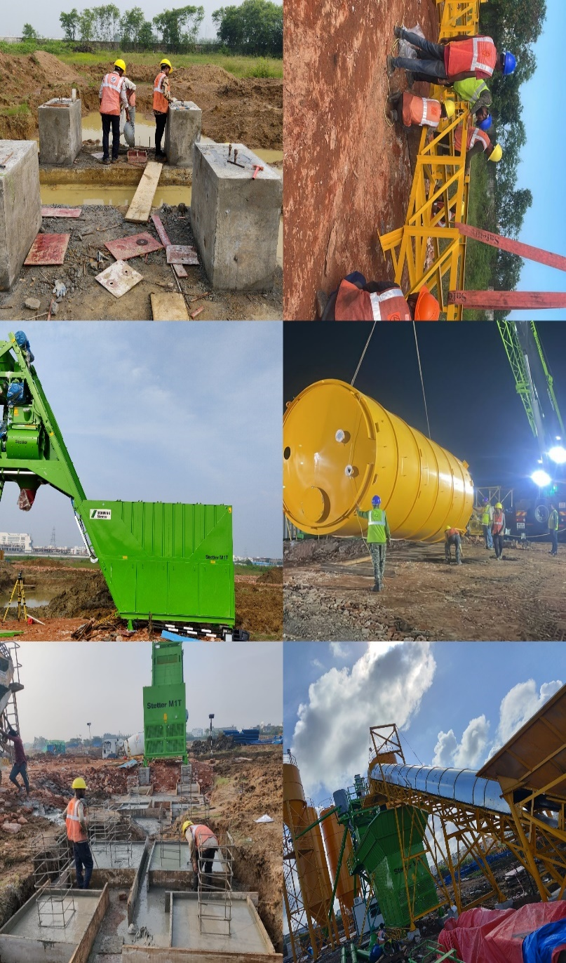
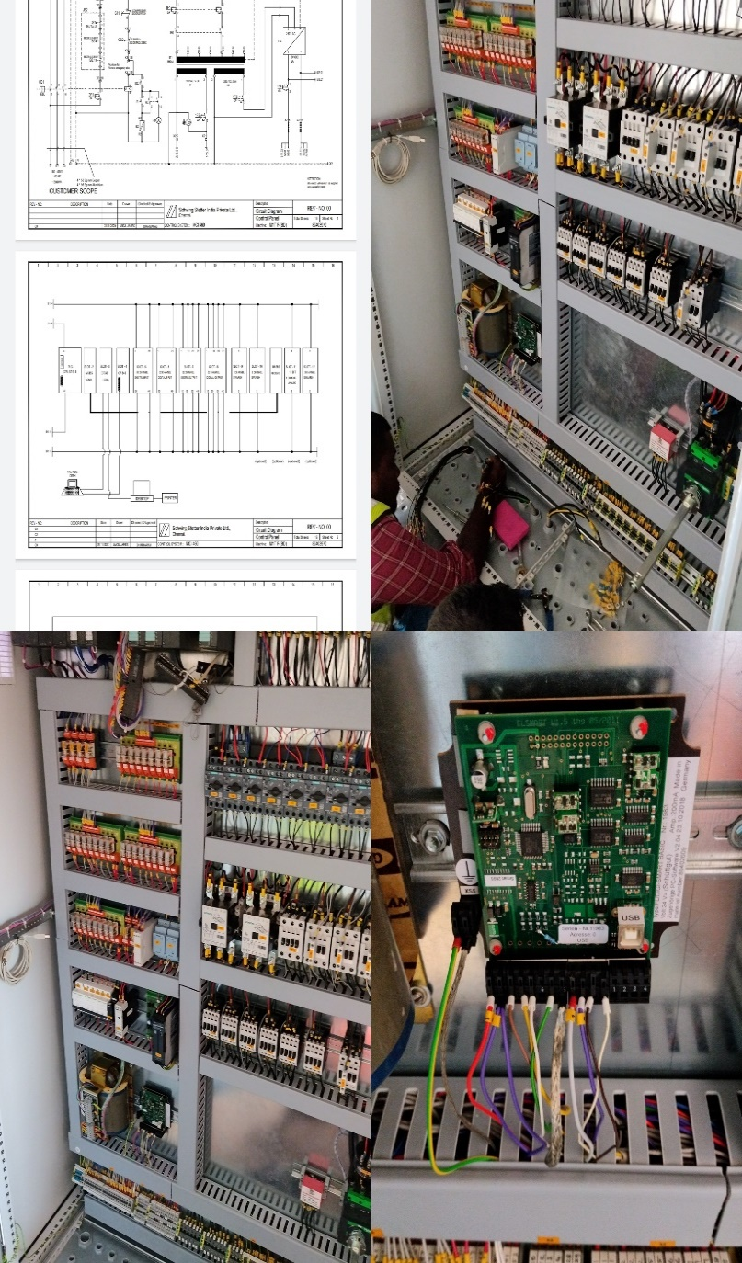
Batching plant
Foundation for erection of a batching plant
Erection of all equipments of an batching plant
Silos motor delta wiring,dust collector and mixer motors connections
Solenoid panel fixing
SCADA software with PLC programming full control panel board wiring for automatic operation of batching plant(right side fig.)
Electrical drawings readings and micro controller installation
Butterfly valves fixing,air compressor fixing with electrical motors.

Slide 4
